Slide 1
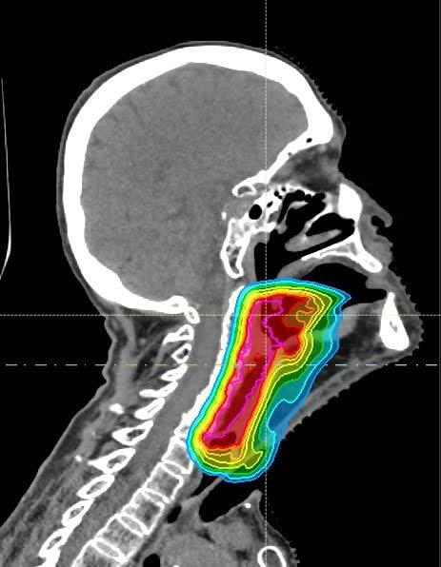
TITLE:CAUSAL MACHINE LEARNING IN ONCOLOGY - CHEMOTHERAPY/RADIOTHERAPY HEAD AND NECK CANCER TREATMENT RESPONSE
14/11/2025
Does adding chemotherapy to radiotherapy improve survival for real-world patients for whom does it help or harm at what time ?

Slide 2
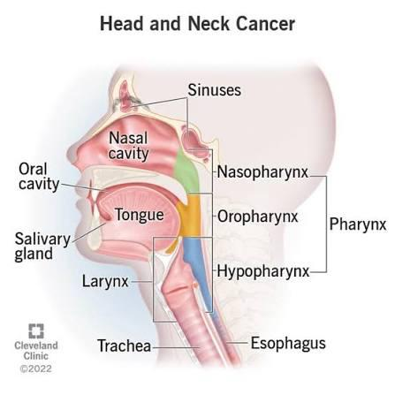
Head and Neck Cancers(HNC)
Cancers that affect your mouth, throat or other parts of your head and neck

Slide 3
Head and Neck Cancers (HNCs) account for > 900,000 cases and 390,000 deaths annually worldwide(Iwatsubo et al, 2019).
N

Slide 4
Radiotherapy (RT) is a foundational treatment.
many patients receive chemoradiotherapy (ChemoRT), adding systemic chemotherapy to improve tumor control.
N

Slide 5
Problem Statement
Management of head and neck cancers—especially HPV-associated OPSCC—varies widely across centers,
Randomized trials are scarce or outdated → clinicians rely on real-world data.
Observational data are confounded → standard ML fails to estimate causal effects.
THE CHALLENGE

Slide 6
Content overview
1
2
3
Why Causal Machine Learning?
Dataset Construction & Preprocessing
Propensity Score Estimation
4
5
6
Survival Modeling Framework
Person-Period (Discrete-Time) Modelinge
Causal Forest for Individualized Treatment Effects

Slide 7
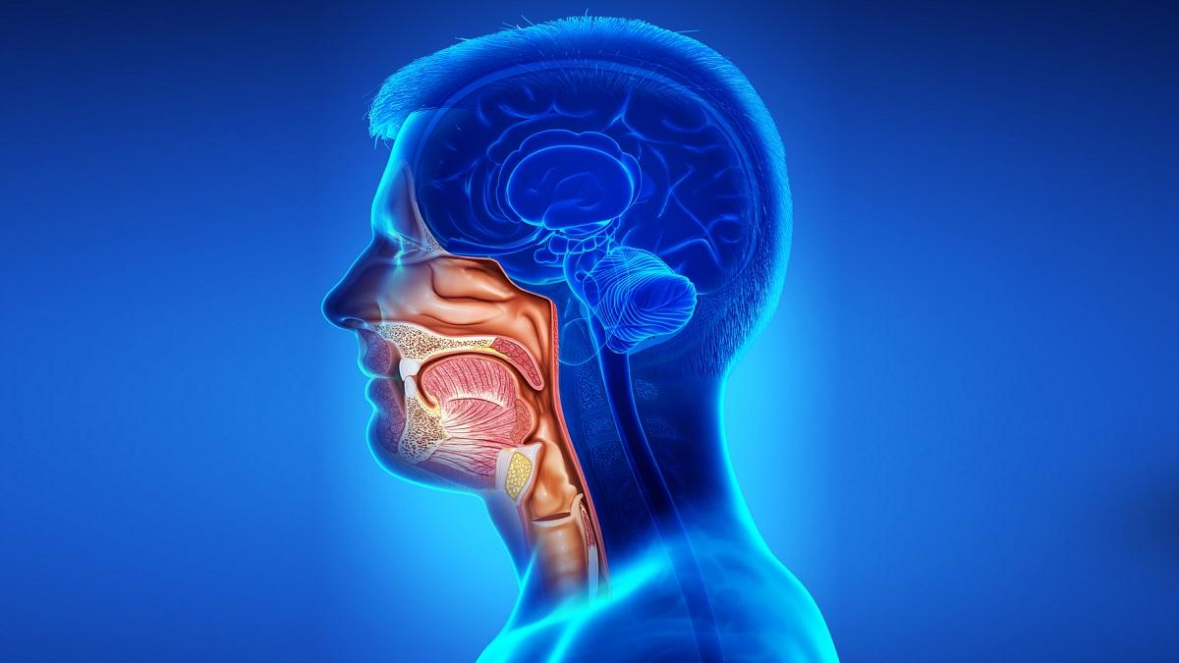
Causal Machine Learning enables us to reason about the effects of changes to this process (interventions) and what would have happened in hindsight (counterfactuals)
Causal Machine Learning

Slide 8
Regular Machine Learning Vs Causal Machine Learning
Aspect | Regular ML | Causal ML
Goal | Predict outcomes | Estimate treatment effects
Focus | Associations (`P(Y) | Estimate effect Y(1)−Y(0)Y(1)
Key Question | “What is likely to happen?” No counterfactuals | “What would happen if we change treatment?”
Methods | Classification, regression, deep nets | Propensity scores, , causal forests, DML
 | Learns spurious correlations | Removes confounding- via Propensity Scores & IPW

Slide 9

A chest X-ray deep learning study (Zech et al., PNAS 2018) showed that the model was not learning lung pathology it was learning hospital-specific artifacts, such as metallic tokens/markers and scanner signatures.
THE PROBLEM

Slide 10
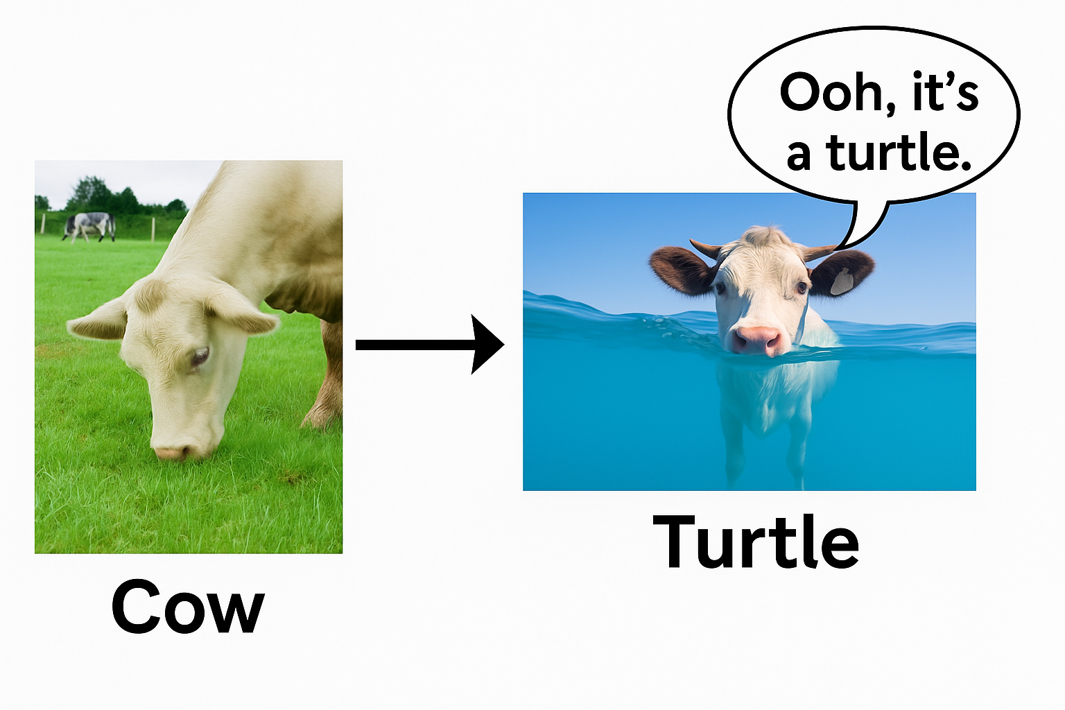
A model might latch onto patterns that don't genuinely reflect the underlying reality.

Slide 11
A chest X-ray deep learning study (Zech et al., PNAS 2018) showed that the model was not learning lung pathology it was learning hospital-specific artifacts, such as metallic tokens/markers and scanner signatures.
THE PROBLEM

Slide 12
X-rays from Hospital A had more severe pneumonia cases and a distinct metallic marker in the corner of the image.
The model learned:
metal marker = severe pneumonia,
instead of learning actual disease patterns in the lungs.
Company Name
THE PROBLEM

Slide 13
In health care this would appear highly accurate in one setting but fail catastrophically elsewhere, leading to:
delayed treatment,
inappropriate admissions,
false reassurance or unnecessary dose escalation
Company Name
The Challenge Remains

Slide 14
Recommendations exist:
RT alone for T1N1
RT or CRT for T2N1
CRT for T1–T2 N2a–N2b
But these recommendations are based on low-level evidence
THE CHALLENGE

Slide 15
Recommendations exist:
A multi-center cohort, CRT did not improve OS for T1–T2 N1–N2a patients.
Only younger patients (≤70) with T2 N2b showed improved locoregional control—not overall survival.
Other studies show no difference in survival between older and younger patient on ChemoRT
Older patients derived no clear benefit, raising concern about toxicity burden

Slide 16
Goal:
Overall treatment effect (ATE)
Individualized effects (CATE)
Time-varying treatment effects
Survival differences between RT and ChemoRT

Slide 17
- Causal machine learning (ML) offers flexible, data-driven methods for predicting treatment outcomes including efficacy and toxicity, thereby supporting the assessment and safety of drugs.
- A key benefit of causal ML is that it allows for estimating individualized treatment effects.
- Hence that clinical decision-making can be personalized to individual patient profiles (Feuerriegel et al, 2023),
Cont!e

Slide 18
Our goal is not prediction; it is estimating treatment effects
- We are not just asking “Who will respond?”
- We are asking:
“What difference does chemo + radiotherapy make compared to radiotherapy alone for this patient group after adjusting the confounders?”
-Only causal ML can answer this counterfactual question

Slide 19
Confounder : A variable that affects both the dependent variable and the independent variable, creating a spurious relationship

Slide 20
Younger patients more likely to get ChemoRT
Standard ML will wrongly learn “younger age = better survival”
Not because of treatment → but confounding.
Perfect Example

Slide 21
Conditional Exchangeability:
Given baseline confounders 𝑋 treatment assignment 𝐴 is independent of potential outcomes:
Y(a)⊥A∣X
Company Name
KEY ASSUMPTION OF CAUSAL

Slide 22
Consistency (SUTVA):
Each patient’s outcome corresponds to the treatment they received, with no interference across patients.
Company Name
KEY ASSUMPTIONS OF CAUSAL ML

Slide 23
Positivity:
Every combination of confounders must have a non-zero probability of receiving either treatment.
Company Name
KEY ASSUMPTION OF CAUSAL ML

Slide 24
Ignorability
Ignorability assumes that after adjusting for all measured confounders,
treatment assignment is ‘as good as random.’
This assumption allows us to estimate causal effects from observational data

Slide 25
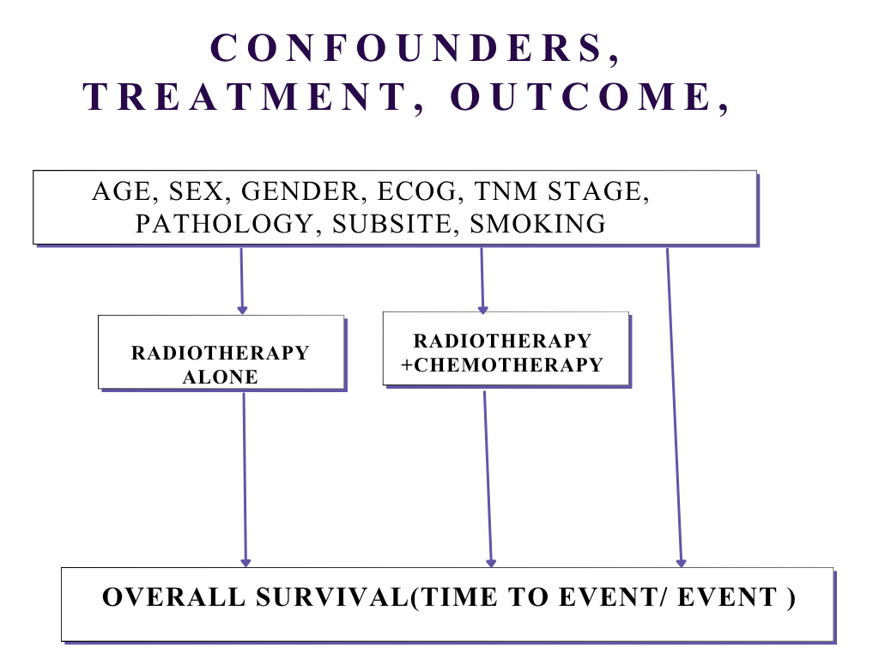

Slide 26
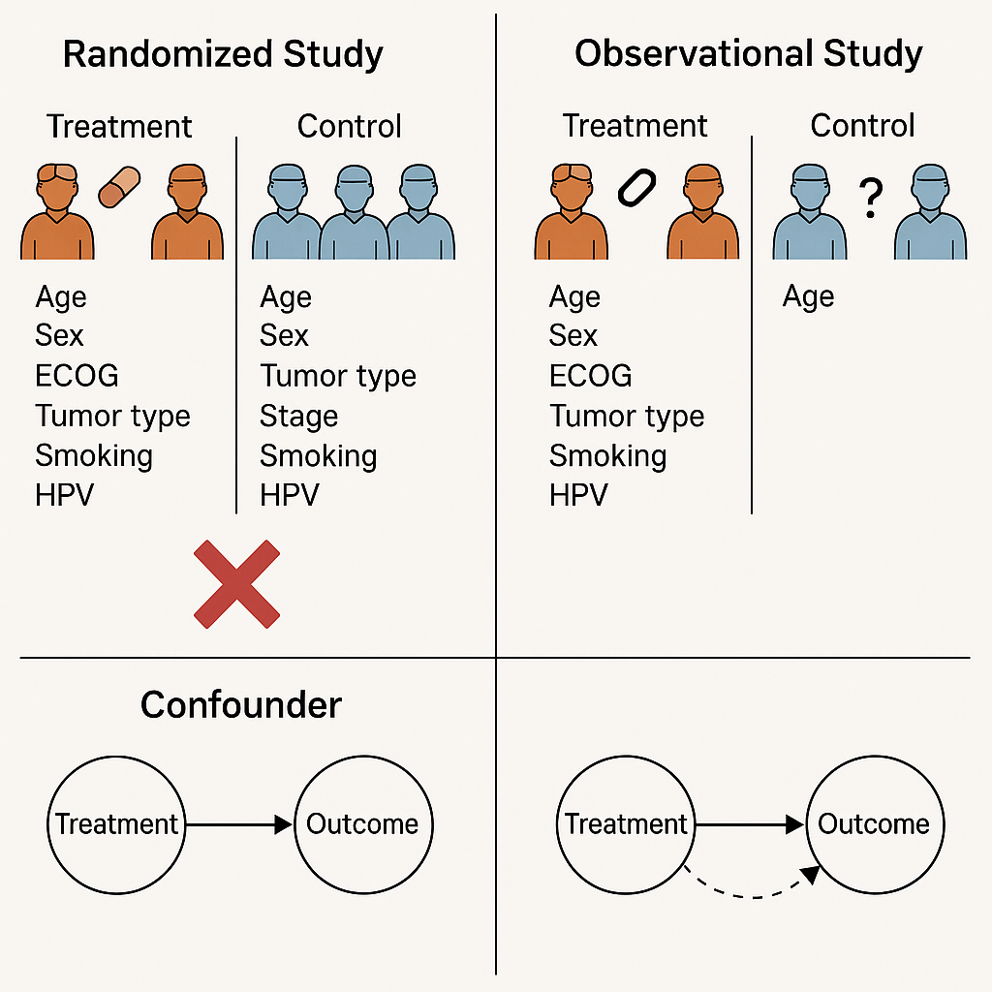
What are we missing?
The counterfactual!

Slide 27
{ATE} = E[Y^{A=1}] - E[Y^{A=0}]
where:
Y(1) represents survival time had all patients received ChemoRT, and
Y(0) represents survival time had all patients received RT alone.
Company Name
AVERAGE TIME EFFECT

Slide 28
(CATE) for a patient with covariates X=xX = xX=x is:
CATE(x)=E[Y(1)−Y(0)∣X=x]
Where:
Y(1)Y(1)Y(1) = potential outcome if treated
Y(0)Y(0)Y(0) = potential outcome if untreated
Company Name
Conditional Average Treatment Effect (CATE)

Slide 29
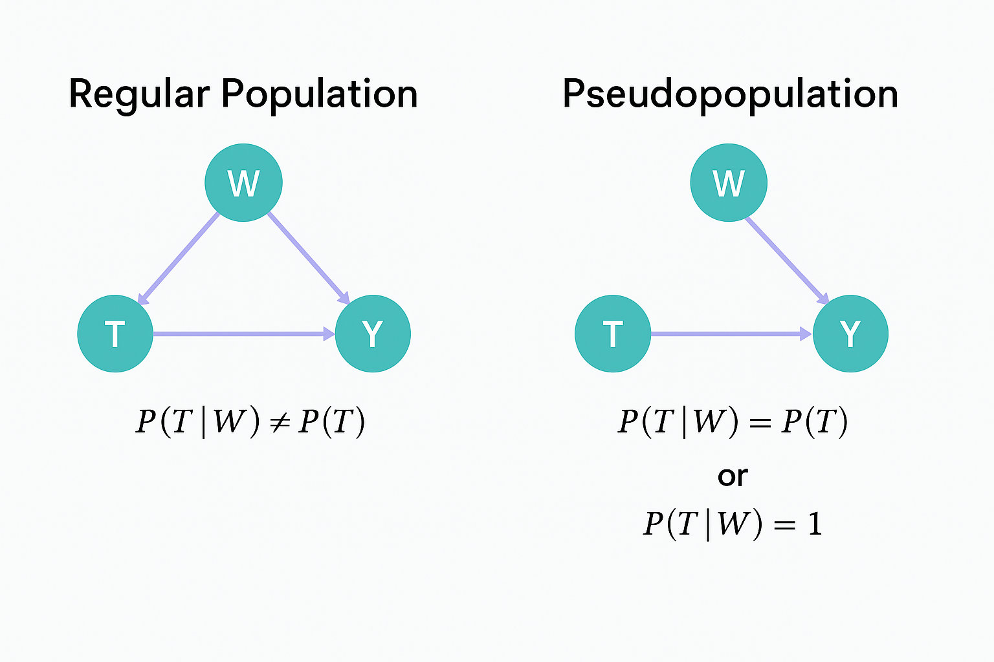
Inverse probability weighting
w_{i​}=1/(e(X_{i}​))+1/(1−e(Xi​))

Slide 30
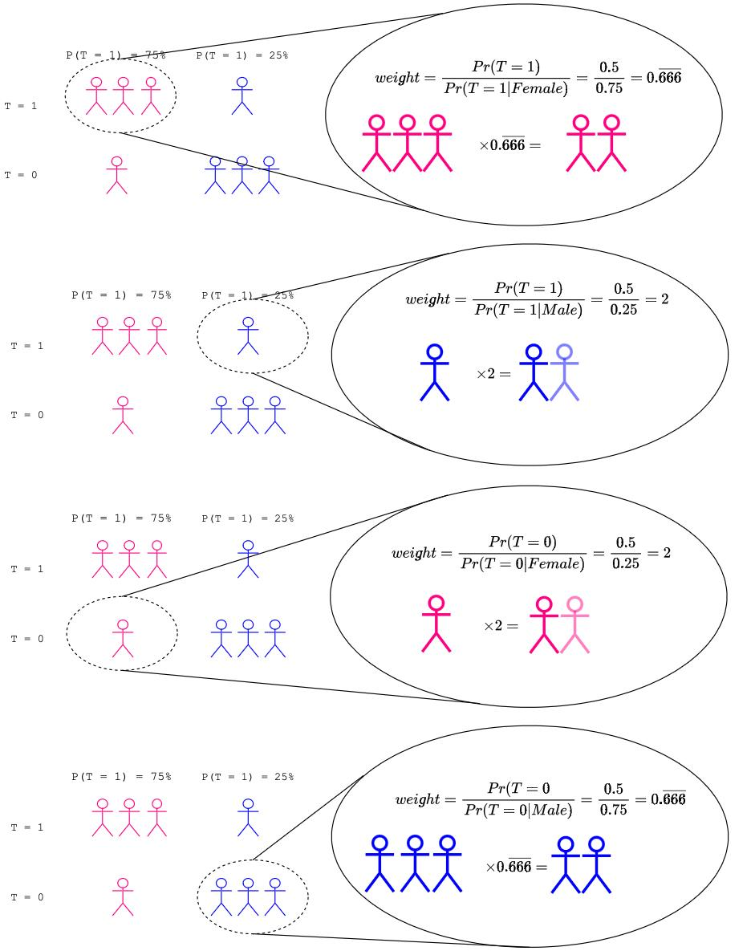

Slide 31
Modules
-Streamlit app
Streamlit
plotly
-File handling
joblib
-For parsing and cleaning
python-dateutil
-Web deployment utilities
requests

Slide 32
Modules
numpy
pandas
scikit-learn
statsmodels
scipy
-Causal inference and ML
econml
causalml
-Survival analysis
lifelines

Slide 33
Step1: Data collection
RADCURE clinical dataset (N > 3,400), a multi-institutional real-world registry of head and neck cancer patients treated with radiotherapy alone, radiotherapy+chemotherapy and radiotherapy+EGFRI:https://www.cancerimagingarchive.net/collection/radcure/
Demographics (age, sex)
Clinical staging (T, N, M, Overall Stage)
HPV status
Smoking history
Pathology subtype
Treatment fields (RT, ChemoRT, RT+EGFRI, PostOp radiotherapy)
Dose & fractionation (Gy, fractions)
Survival information (overall survival time, event indicator)

Slide 34
Step 2: Define key variables
Treatment definition (binary exposure)
treatment = 1 → Concurrent ChemoRT
treatment = 0 → RT alone
Outcome variables
time_os_days
event_os (1 = death, 0 = censored)

Slide 35
Step 3: Causal DAG(Our Assumptions)

Slide 36
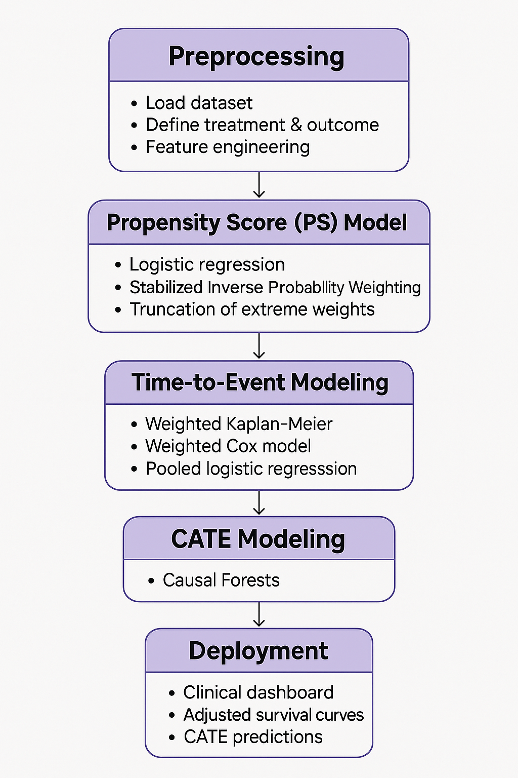
Methodology Workflow

Slide 37
4. Data Cleaning & Harmonization
Data loading: original_radcure_data = pd.read_excel("/content/RADCURE_Clinical_v04_20241219.xlsx")

Slide 38
4. Data Cleaning & Harmonization
Checked for missingness deduced that the missingness was not at random :
Why We Did NOT Drop Missing Rows
Would introduce severe selection bias
Drops clinically important subgroups (HPV-, old patients, poor documentation groups)
Reduces overlap → PS extremes & unstable weights

Slide 39
4. Data Cleaning & Harmonization
Collapsed Rare Categories
High-cardinality clinical variables → unstable models.
We collapsed rare categories to avoid:
Sparse dummy variables
Noisy coefficients
Unstable propensity scores
Variables collapsed:
subsite_clean
pathology_group
primary_site_group
stage

Slide 40
4. Data Cleaning & Harmonization
Created or cleaned variables
Smoking variables:
Smoking_status_clean, smoking_missing
smoking_py_clean
HPV status:
hpv_clean (+ missing indicator)
T/N/M staging recoded- t,n,m ,stage, t,n,m_missing
Primary site groups: OPX, Larynx, Hypopharynx, Oral cavity
ECOG performance status
Created ecog_ps_missing indicator
Treatment indicator (treatment) normalized to 0/1
Outcome variables : event_os, time_to_event

Slide 41
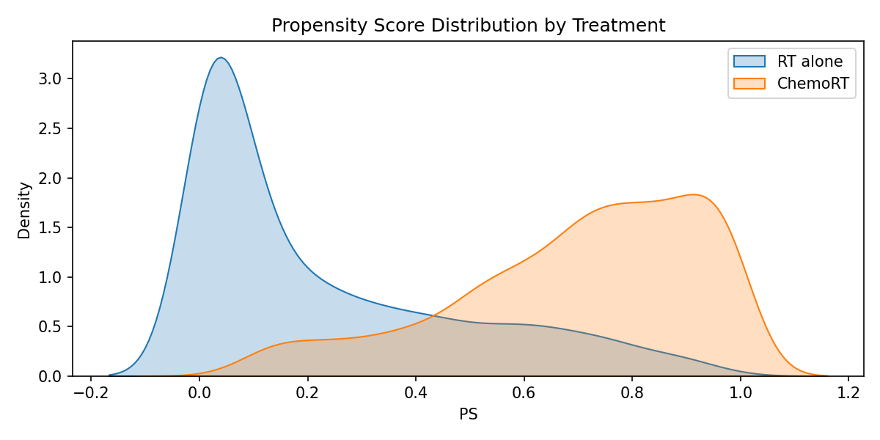
Propensity Distribution

Slide 42
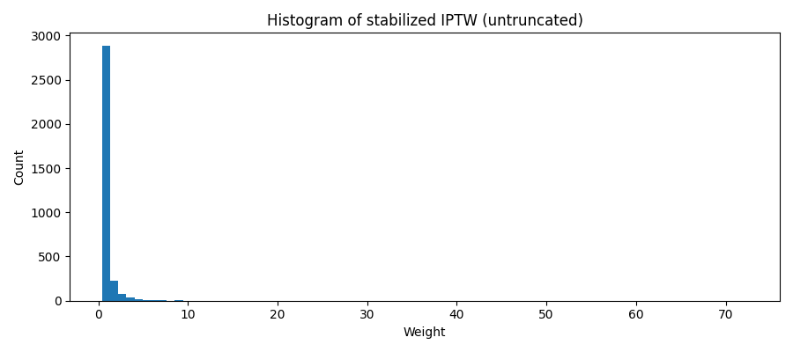
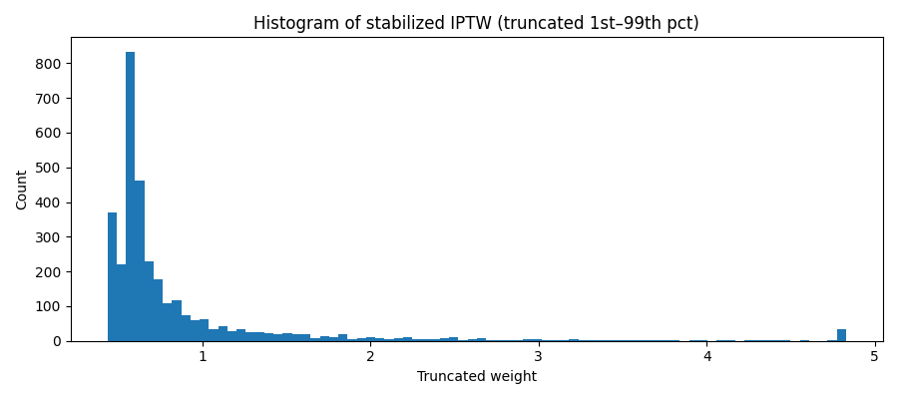
(Inverse Probability Treatment Weighting IPTW

Slide 43
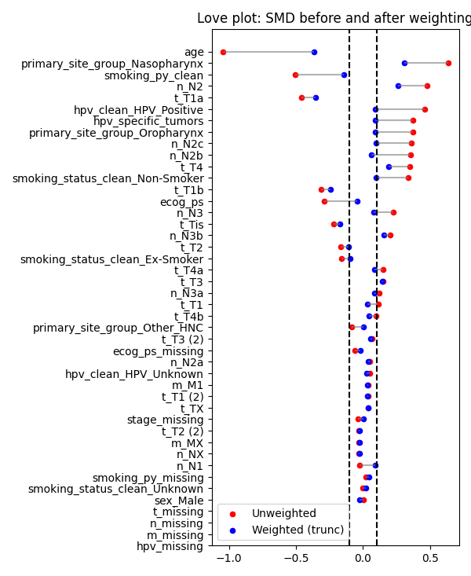
Love plot SMD before and after weighting

Slide 44
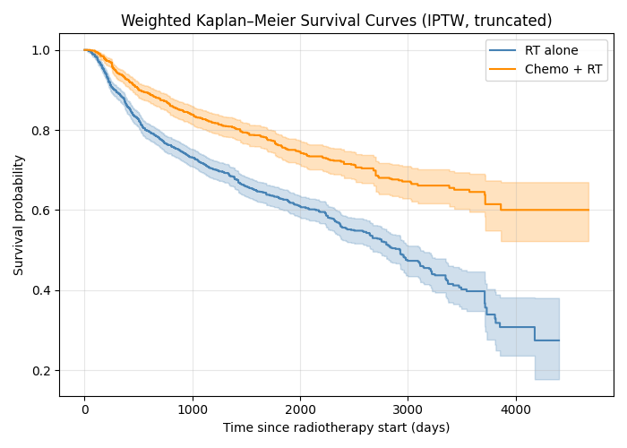
Weighted Kaplan -Meier survival curves:

Slide 45
Cox proportional Hazard
After adjusting for key clinical variables and using inverse probability weights to balance treatment groups, patients who received chemoradiotherapy had about 40–45% lower risk of death compared to those treated with radiotherapy alone. Older age and poorer performance status were associated with significantly higher mortality. Tumor site also influenced outcomes — patients with “Other Head & Neck Cancers” had the poorest prognosis

Slide 46
Cox proportional Hazard - Proportional Hazard assumption
Schoenfeld residuals revealed significant violations of the proportional hazards (PH) assumption for several key covariates including: treatment, age, ECOG performance status, and primary tumor site (p < 0.05). For treatment (p = 0.025), indicating that the treatment effect varied over time. Hence, we interpret the HR as an average effect
Variable 'treatment' failed the non-proportional test: p-value is 0.0318.

Slide 47
Discrete-Time Survival Modeling- Pooled Logistic Regression
Pooled Logistic Regression (PLR) estimates time-varying hazards when survival time is measured in discrete intervals
Converts each patient into multiple “person–period” rows
Models the risk of the event within each interval
logit[P(Y_{it​}=1∣Y_{i,t}−1​=0,X_{i}​)]=β₀​+β_{t}​t+β_{trt​}Ti​+β_{int}​(T_{i}​×t)+β⊤X_{i}​ where: Y_{it}​ = event indicator in interval t T_{i​} = treatment assignment Xi​ = baseline covariates t or period_bin = time effects (flexible specification)

Slide 48
Weighted Kaplan -Meier survival probabilities:
Time point | RT Alone | Chemo+RT | Difference
1-year | 0.88 | 0.93 | +0.05
3-year | 0.72 | 0.83 | +0.11
5-year | 0.63 | 0.76 | +0.13

Slide 49
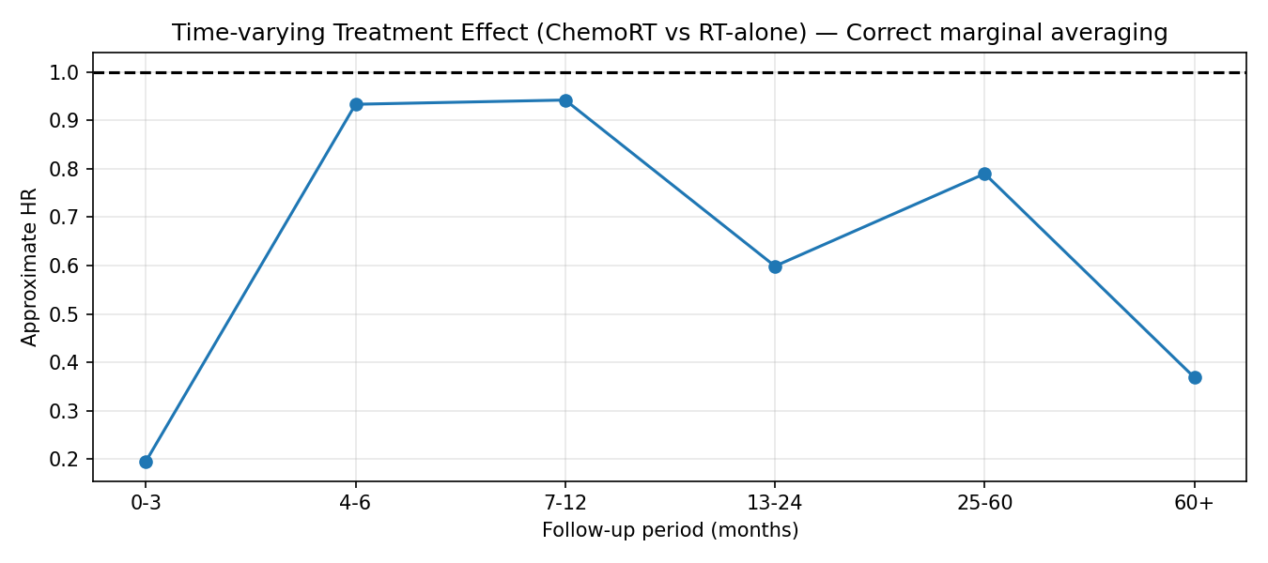
Time-Varying Treatment Effect (Pooled Logistic Regression)

Slide 50
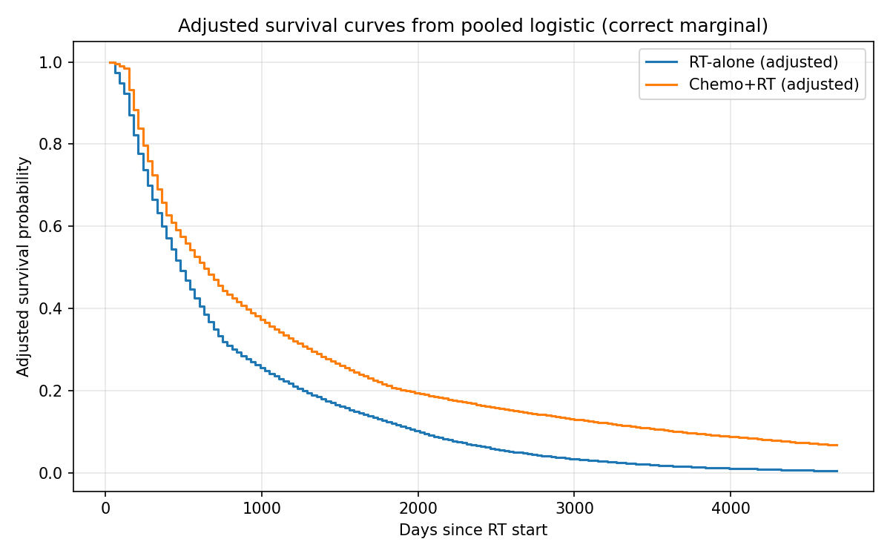
Weighted Kaplan -Meier survival curves:

Slide 51
Causal Forests (Heterogeneous Treatment Effect Estimation) - Causal Forests (CF), an extension of generalized random forests, estimate the Conditional Average Treatment Effect (CATE) as a function of patient covariates. The method employs honest splitting: one part of the data determines the tree structure, while another part estimates treatment effects, reducing bias and enhancing asymptotic consistency. - It captures complex nonlinearities and high-order interactions among clinical variables. - Produces individual-level treatment effect estimates and subgroup-level summaries (e.g., HPV+, T/N stage, smoking burden)

Slide 52
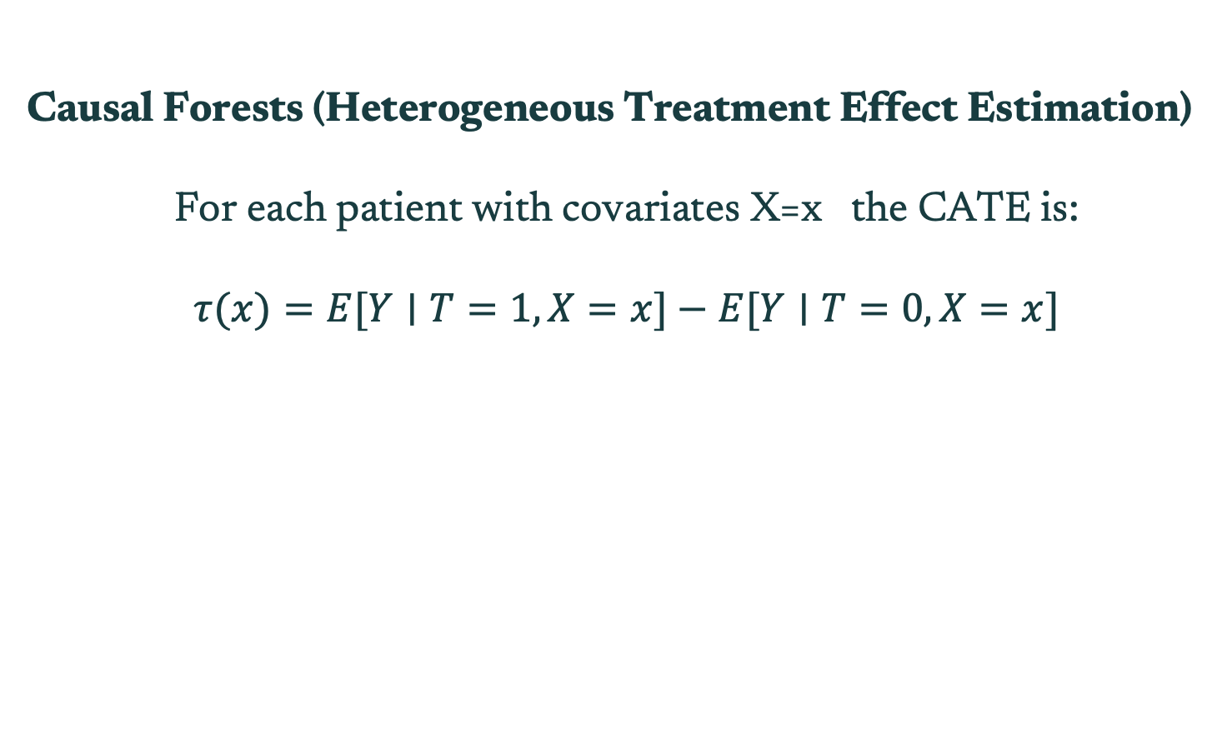
Causal Forests (Heterogeneous Treatment Effect Estimation)
For each patient with covariates X=x the CATE is: $$τ(x)=E[Y∣T=1,X=x]−E[Y∣T=0,X=x]$$

Slide 53
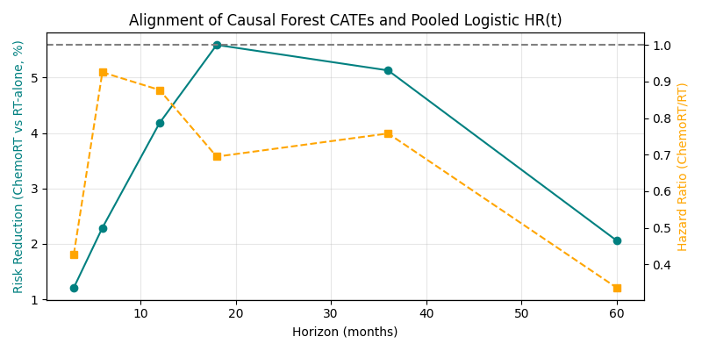
Causal Forest CATE vs Pooled Logistic Regression:

Slide 54
Time-Varying Treatment Effect (Pooled Logistic Regression)
Model Performance
AUC (Train/Test): 0.760 / 0.735
Brier Score: 0.197
Max Coefficient Magnitude: 3.19 (well-controlled; no exploding effects
The pooled logistic model reveals a time-varying benefit, strongest early and very late, milder in mid-follow-up.

Slide 55
Adjusted Survival (Weighted Kaplan–Meier)
Median Survival
RT alone: 2,929 days
Chemo + RT: Not reached (survival curve does not fall below 0.5)
Log-rank p-value < 0.00001 → Strong evidence of overall benefit in unadjusted survival.

Slide 56
Heterogeneous Treatment Effects (Causal Forest CATE)
Horizon 3 months:
Mean CATE: -0.0121
SD(CATE): 0.0340
Horizon 6 months:
Mean CATE: -0.0229
SD(CATE): 0.0624
Horizon 12 months:
Mean CATE: -0.0418
SD(CATE): 0.1303
Horizon 18 months:
Mean CATE: -0.0559
SD(CATE): 0.1568
Horizon 36 months:
Mean CATE: -0.0513
SD(CATE): 0.1558
Horizon 60 months:
Mean CATE: -0.0206
SD(CATE): 0.1508

Slide 57
Heterogeneous Treatment Effects (Causal Forest CATE)
Not all HNSCC patients benefit equally from concurrent chemotherapy.
Benefit depends strongly on tumor biology and patient fitness.

Slide 58
Heterogeneous Treatment Effects (Causal Forest CATE)
Groups with higher benefit from supporting by literature):
HPV-positive OPSCC
T2–T3 tumors
N2b/N2c nodal disease
Patients ≤70 years
Low comorbidity burden (ECOG 0–1)

Slide 59
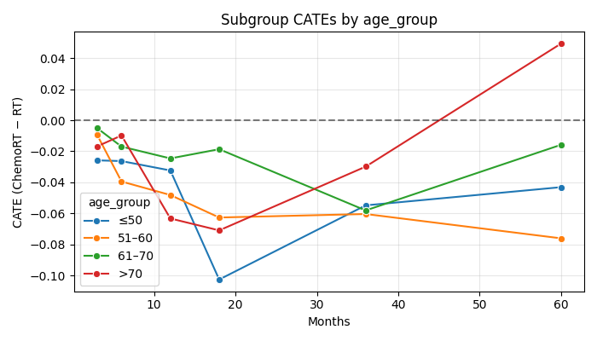
Subgroup CATE By Age:

Slide 60
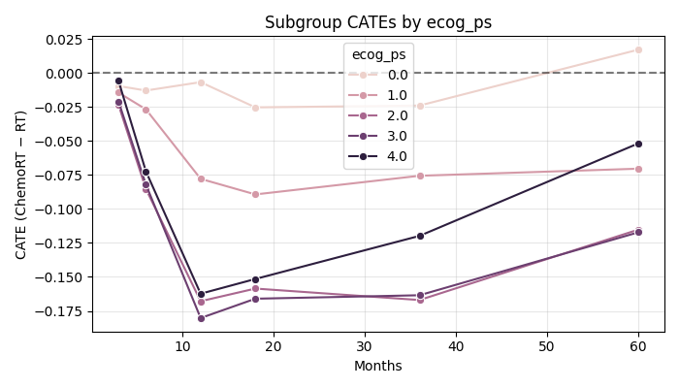
Subgroup CATE By ECOG:

Slide 61
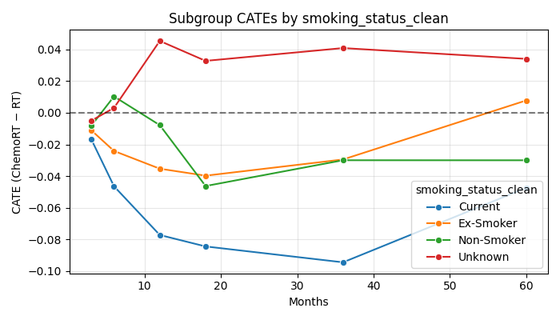
Subgroup CATE By smoking status:

Slide 62
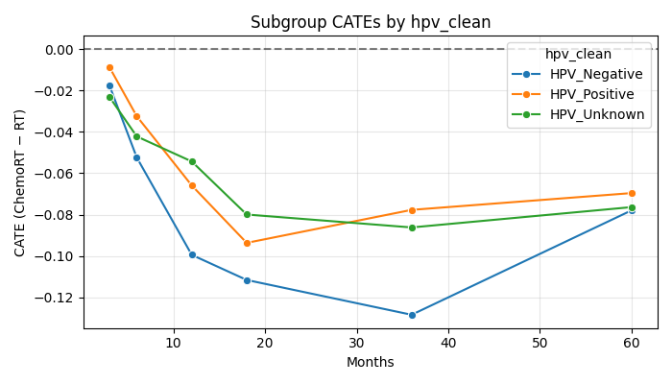
Subgroup CATE By HPV status:

Slide 63
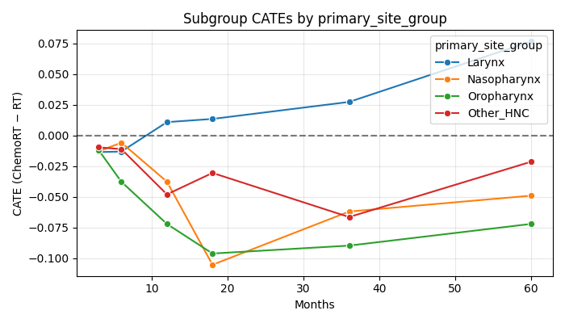
Subgroup CATE By primary tumor site:

Slide 64
Compare curves: Causal Forest CATE and Pooled Logistic HR(t):

Slide 65
“Correlation does imply causation”

Slide 66
Future Directions
Multimodal Patient-Level Digital Twin for HNSCC
Using causal ML + survival models + radiomics:
simulate outcomes under RT alone vs CRT
estimate recurrence risks

Slide 67
Deployment
Multimodal Patient-Level Digital Twin for HNSCC
Using causal ML + survival models + radiomics:
simulate outcomes under RT alone vs CRT
estimate recurrence risks

Slide 68
Feuerriegel, S., Frauen, D., Melnychuk, V. et al. Causal machine learning for predicting treatment outcomes. Nat Med 30, 958–968 (2024). https://doi.org/10.1038/s41591-024-02902
Buchberger, A. M. S., Strzelczyk, E. A., Wollenberg, B., Combs, S. E., Pickhard, A., & Pigorsch, S. U. (2021). Report on late toxicity in head-and-neck tumor patients with long-term survival after radiochemotherapy. Cancers, 13(17), 4292. https://doi.org/10.3390/cancers13174292
Adrian, G., Rudolfson Falklind, N., McDowell, L., & Gebre-Medhin, M. (2025). Chemoradiation therapy versus radiation therapy alone in T1–2 oropharyngeal cancer with low-volume neck disease: A population-based cohort study using the Swedish Head and Neck Cancer Register. International Journal of Radiation Oncology, Biology, Physics. Advance online publication. https://doi.org/10.1016/j.ijrobp.2025.08.040
Zech JR, Badgeley MA, Liu M, Costa AB, Titano JJ, Oermann EK. Variable generalization performance of a deep learning model to detect pneumonia in chest radiographs: A cross-sectional study. PLoS Med. 2018 Nov 6;15(11):e1002683. doi: 10.1371/journal.pmed.1002683. PMID: 30399157; PMCID: PMC6219764.
References

Slide 69
Thank you
Danke!

